Slide 1
COSP230 Ch. 7
Displaying Pictures in a GridView

Slide 2
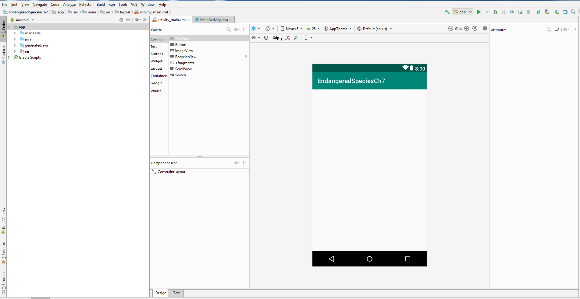
Start of Project (Delete HelloWorld text, select Nexus 5, keep as Constraint Layout):

Slide 3
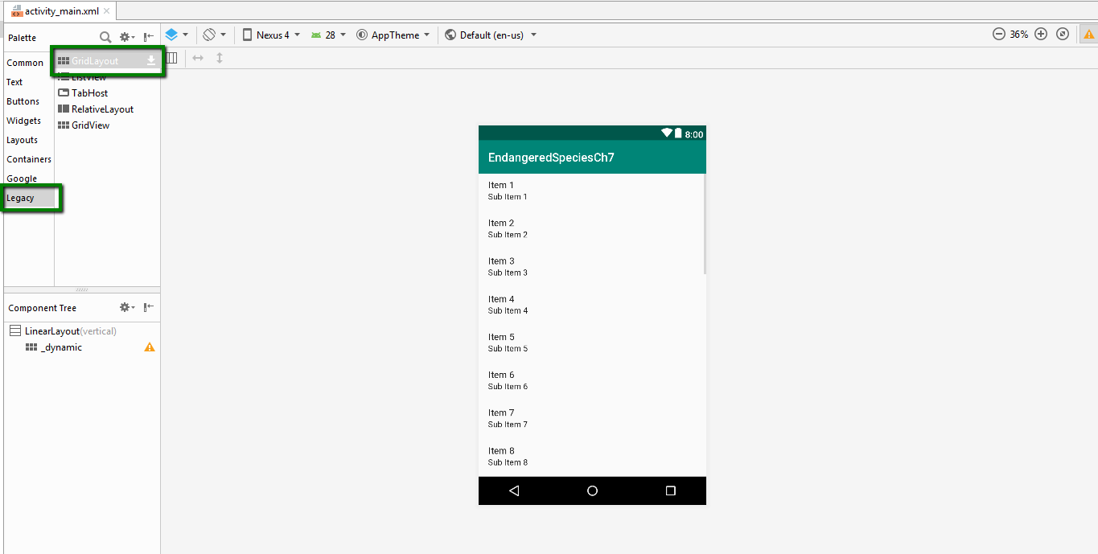
Drag and Drop GridView from Legacy in Palette

Slide 4
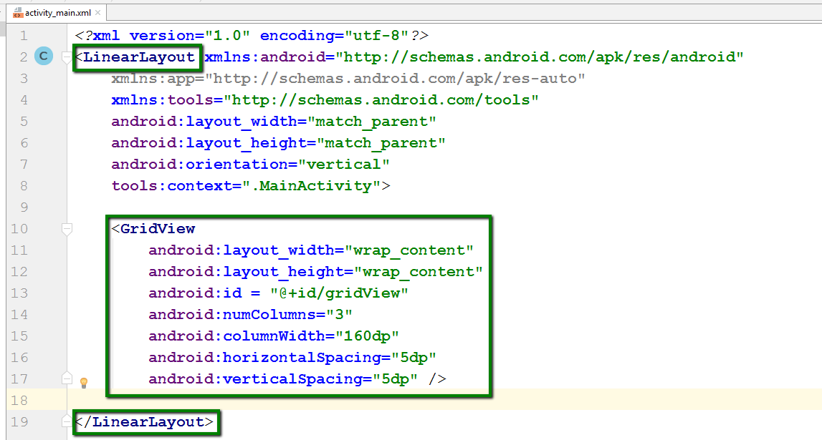
Update activity_main.xml for GridView
Replace text for current layout with LinearLayout as shown at right.
Add an orientation of “vertical”
Only constraints needed are shown in picture. Delete all others.

Slide 5
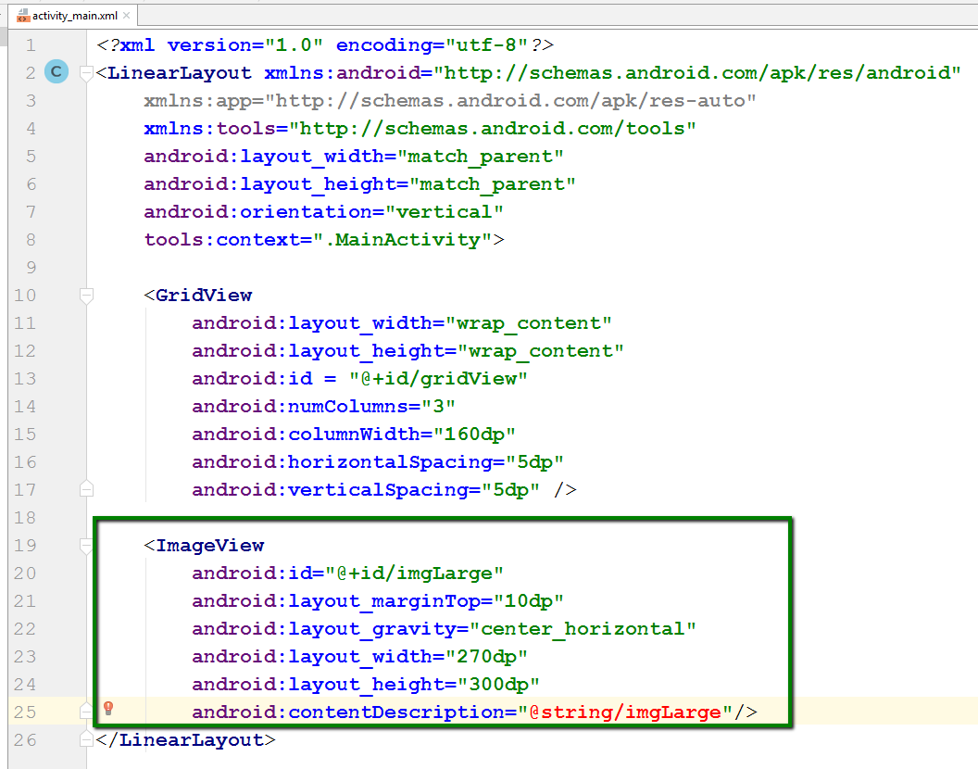
Update activity_main.xml to add ImageView
Add code in box as shown.
There will be an error on the contentDescription attribute.
We’ll fix it later.

Slide 6
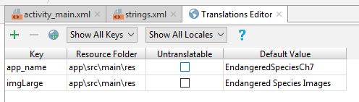
Add keys in Translations Editor
Open the Translations Editor
Add the keys in the table on the right:

Slide 7
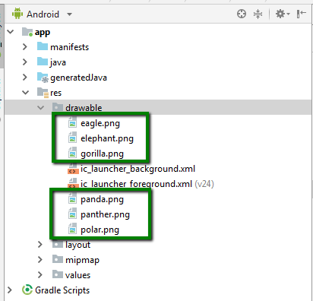
Add graphic files to drawable folder
Download the image files from the Ch 7 Images folder (Endangered Species subfolder) in Files and save to Desktop
Copy and paste the files in the green boxes into the drawable folder

Slide 8
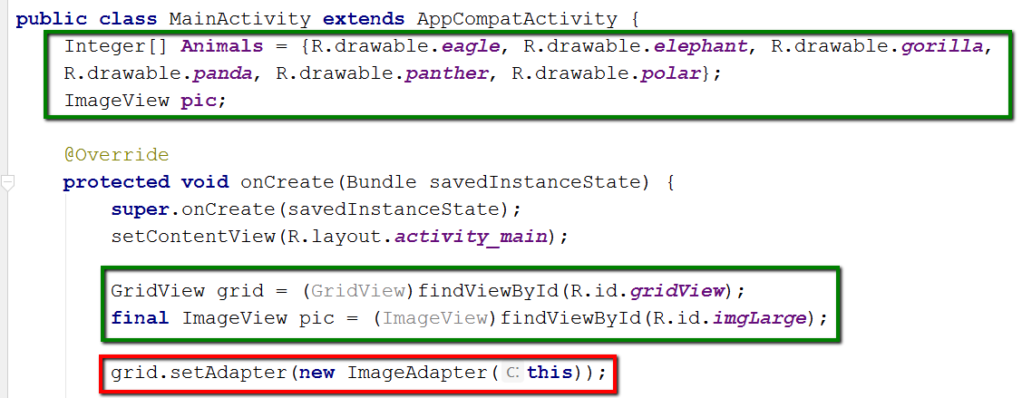
Update java code in MainActivity.java
Add code in all colored boxes as shown
Code in red box will cause an error, but it will be fixed in next slide

Slide 9
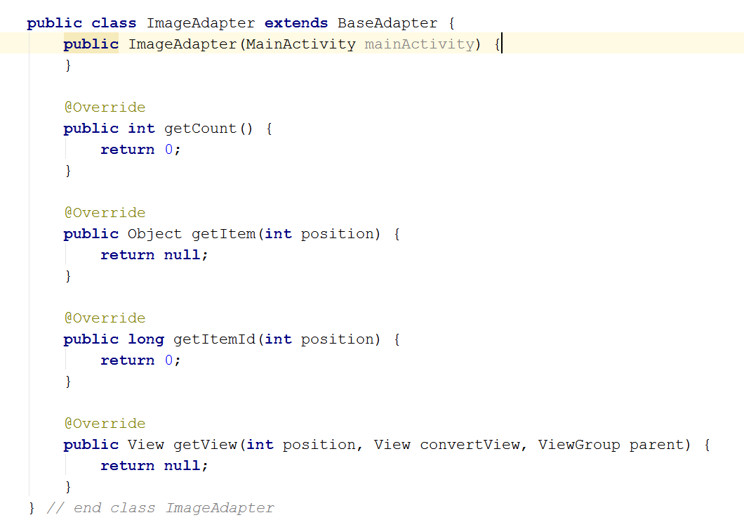
Define ImageAdapter class
Add code at right as shown after onCreate method and before end of MainActivity class.

Slide 10
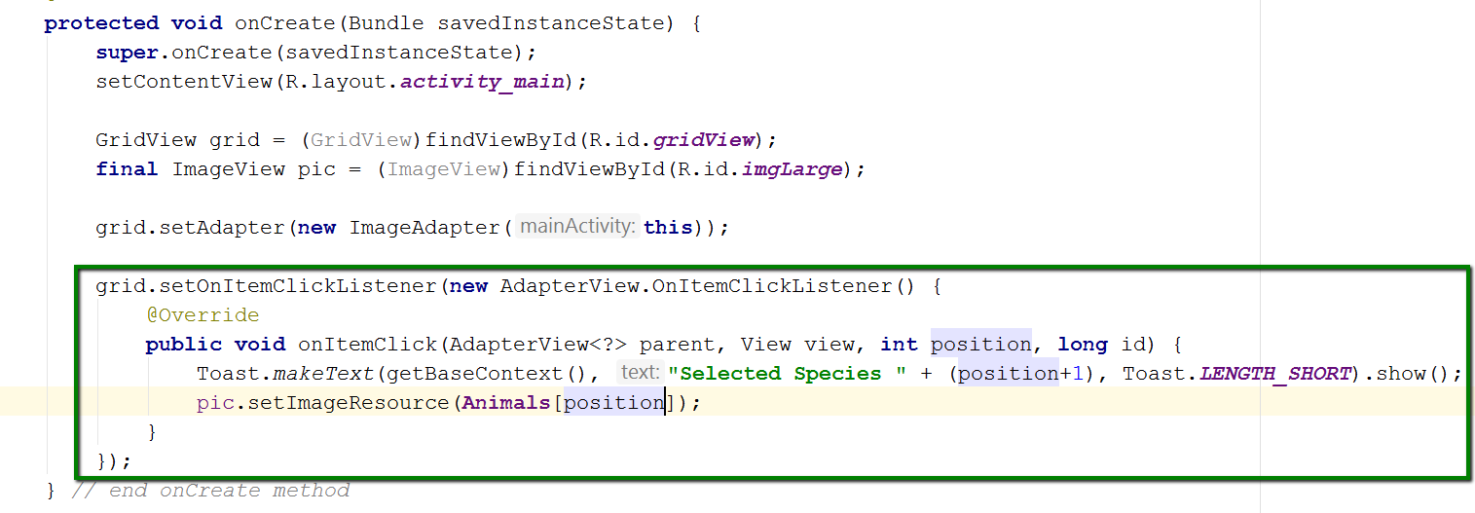
Add setOnItemClickListener for GridView
Works like setOnClickListener for buttons
onItemClick() – takes action when image is clicked
getBaseContext() – turns Toast into an AlertDialog.
setImageResource() – indicates which image is selected.

Slide 11
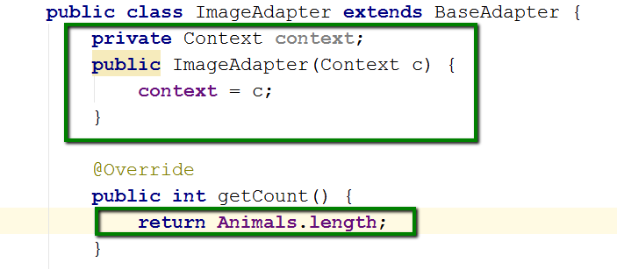
Update Image Adapter class (part 1)
In the ImageAdapter class:
Add a private member variable of type Context named context.
Change parameter of constructor to Context c
Add context = c statement
In getCount, return length of array Animals.

Slide 12
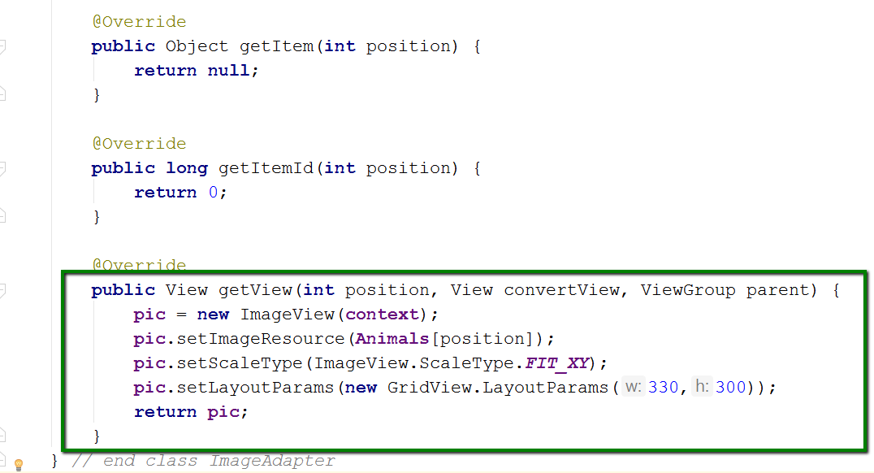
Update ImageAdapter class (Part 2)
getItem() and getItemId() methods do not change.
getView() method uses the pic object to temporarily hold each image displayed in the GridView
The pic object will return a scaled, resized image.
Scale types are CENTER, CENTER_CROP, and FIT_XY.
LayoutParams are width and height, in that order

Slide 13
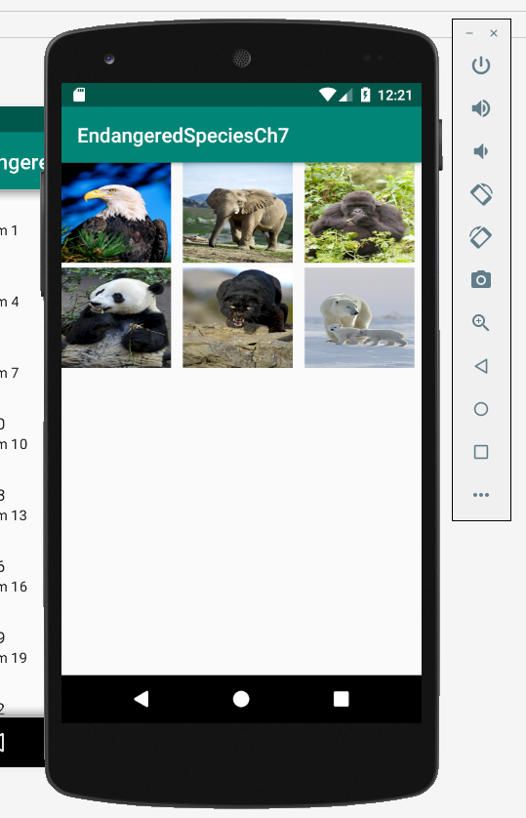
Run the app. You should get this:

Slide 14
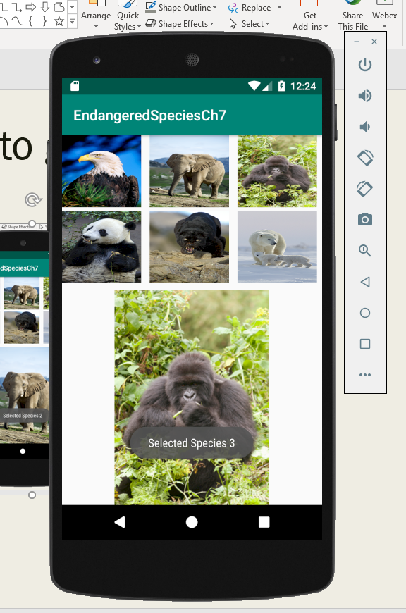
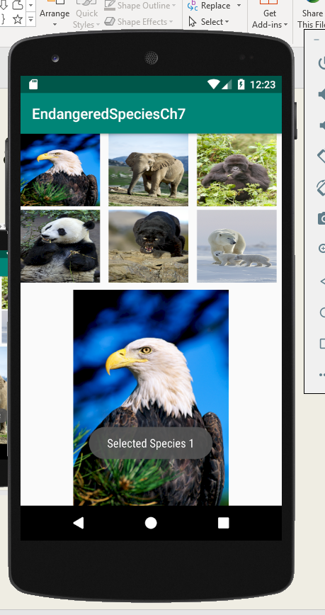
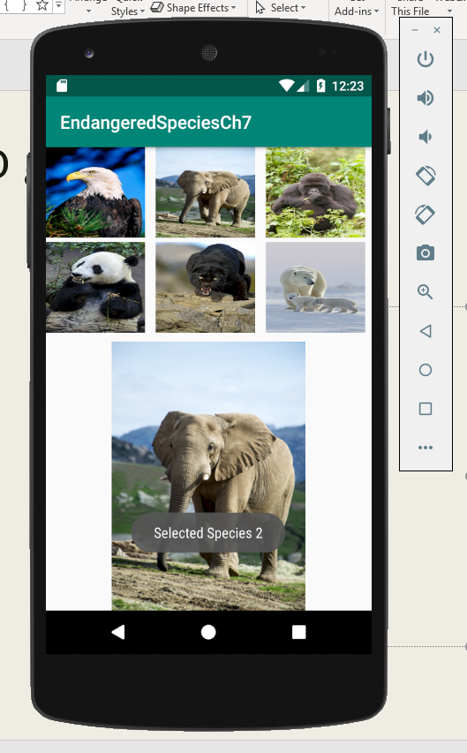
Click the pictures to get output (get 3):

